Slide 1
AML-2304 Natural Language Processing

Slide 2
Natural Language Processing - Text Wrangling and Cleaning
Notes:
d

Slide 3

Contents
Understanding NLP
NLP Workflow
Sentence Splitting
Word Tokenization
Regular Expressions
Removal of Stop Words
Stemming and Lemmatization

Slide 4
Understanding NLP
Natural Language Processing (NLP) is a subfield of Artificial Intelligence dealing with human natural language and the computerized text’s interactions. NLP is mainly regarding processing and analyzing large amounts of natural language data.

Slide 5
NLP Workflow
Textual Data Collection
Text Preprocessing
Exploratory Data Analysis
Evaluation and Deployment
Modelling or Pattern Mining
Vectorization and Feature Engineering
Text Normalization

Slide 6
Regular Expressions
Basically it is “Text Preprocessing”
e.g. txt = “you can contact me at 647-123-456 or 647-987-321
With regular expression we can find and replace such patterns
We can use a python module called: re
Do you what is text indexing in python ?
Do you know what is a raw text in python ?

Slide 7
Regular Expressions
What can you do with “re” module ?
finditer , findall, search, match
You can split text by using “split” function
You can replace text by using “sub” function

Slide 8
Regular Expressions
How to use the “re” module ?
Import re
Create an re.compile object , by providing the target pattern
Call the required function (e.g. sub) from the compile object by providing the target text

Slide 9
Regular Expressions
How to find patterns ?
Special “tools” for special tasks.. + , ^ , $ , * etc
Find
Pattern = “hi+”
Replace
Pattern with “x”
Result
“x x x to you”
String = “hi hii hiiiiii to you”
+ : matches one or more occurrences of the pattern left to it

Slide 10
Regular Expressions
More Special “tools” such as [] , {} , () etc
Find Pattern
[@ !]
Replace
Pattern with “^”
Result
“my email is abc^com ^”
String = “my email is abc@com !”
[] : matches any character inside the [] , one by one, with “or” logic

Slide 11
Regular Expressions
More Special “tools” for sequences \d , \w etc
find all digits
/d
Replace
Pattern with “^”
Result
“I have ^ brothers and ^ sisters
String = “I have 3 brothers and 2 sisters”
\d : matches sequence of digits (numbers 0-9).

Slide 12
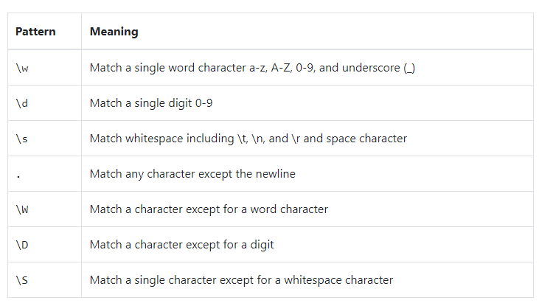
Regular Expressions
Cheat Sheet :
Full Cheat Sheet Here

Slide 13
Regular Expressions
Complicated Pattern
“You can reach me at +1-123-456-7890 or +1-321-789-1238”
+1-123-456-7890
“You can reach me at phone_number or phone_number”

Slide 14
Text Wrangling
Tokenization:
Tokens can be words, clauses, phrases or sentences which are part of an actual text. Textual data is divided into classified set of tokens which cause significant advantage to business use case.

Slide 15
Text Wrangling
Sentence Tokenization:
Code:
nltk.tokenize.sent_tokenize("hello everyone. how are you")
Output:
['hello everyone.', 'how are you']

Slide 16
Text Wrangling
Word Tokenization:
Code:
nltk.tokenize.word_tokenize("hello everyone, how are you")
Output:
['hello', 'fahad', ',', 'how', 'are', 'you']

Slide 17
Word Tokenization
There are other Tokenizers as well
Activity Alert!
TreeBankWordTokenizer
PunktWordTokenizer
WordPunctTokenizer
RegExpTokenizer
TweetTokenizer
What do these tokenizer do ?
Fire up your IDE and explore
With examples

Slide 18
Stop Words
Stop words are the words which are used most by humans and add less significance to the business use case in hand.

Slide 19
Removal of Stop Words
A list of stop words can be obtained from the nltk library. We can then use a loop to remove the stop words from the text.
Remember: Text first needs to be tokenized by words
import nltk
from nltk.corpus import stopwords
nltk.download('stopwords')
list_of_stop_words = stopwords.words('english')
list_of_stop_words[0:5]
['i', 'me', 'my', 'myself', 'we']

Slide 20
Removal of Stop Words
# removing stop words
# first , tokenize
tokens = nltk.tokenize.word_tokenize("hello there, how is every one doing")
Print(tokens)
['hello', 'there', ',', 'how', 'is', 'everyone', 'one', 'doing']
# remove stop words using for loop or a list comprehension
token_without_stopwords = [i for i in tokens if i not in list_of_stop_words]
Print(token_without_stopwords)
['hello', ',', 'everyone', 'one']
Activity Alert!
Can you find stop words for other languages ? What if you want to remove a word from a stop word list ?

Slide 21
Stemming
Stemming:
Stemming is a technique which reduces a word to its stem or root format, by using a set of rule
We can use PorterStemmer from the nltk library, it’s a basic and simple stemmer

Slide 22
Stemming
How to use PorterStemmer ?
# import the PorterStemmer
from nltk.stem import PorterStemmer
# make an instance of the PorterStemmer class
ps = PorterStemmer()
# use a for loop or list comprehension to stem every word
# Remember to Tokenize the text first
tokens = ['programs’ ,'programmer’ ,'programming’ ,'program']
[ps.stem(i) for i in tokens]
Activity Alert!
Why did we get ‘programm’ for token programmer ? Can you use any other stemmer to fix that?
['program', 'programm', 'program', 'program']

Slide 23
Lemmatization
Lemmatization:
It is a technique like stemming which reduces a word to its root format, but by using a dictionary instead of rules.
We can use WordNetLemmatizer from the nltk library

Slide 24
Lemmatization
How to do Lemmatization?
# import the Lemmatizer
from nltk.stem import WordNetLemmatizer
lem = WordNetLemmatizer()
# use a for loop or list comprehension to lemm every word
# Remember to Tokenize the text first
tokens = ['programs','programmer','programming','program']
[lem.lemmatize (i) for i in tokens]
Activity Alert!
There are other Lemmatizers as well. Can you find out how they are different?

Slide 25
Assignment on Text wrangling and cleaning
Sample of text we are processing:
This movie made it into one of my top 10 most awful movies. Horrible. I don’t care if it makes 1 million, 10 M , or 100. There wasn't a continuous minute where there wasn't a fight with one monster or another. There was no chance for any character development, they were too busy running from one sword fight to another. I had no emotional attachment ( except to the big bad machine ## that wanted to destroy them). If you disagree with me, you can send your thoughts to idonotcare@leavemealone.com

Slide 26
Assignment on Text wrangling and cleaning
Write python code to apply the following on above text and return the final text
Removal of special characters and extra spaces and expanding Contractions
Use regular expression to simplify digits and emails
Tokenization
Removal of Stop words
Stemming / Lemmatization

